Slide 1

Spatial data
Visualization spatial data
Ruslan Bobov

Slide 2
Introduction
What is Spatial Data?
Spatial Data Types
Vector Data
Raster Data
Visualization of Spatial Data

Slide 3
What is Spatial Data?
Spatial Data – it is the data or information that identifies the geographic location of features and boundaries on Earth , such as natural or constructed features, oceans , and more .
Spatial data is usually stored as coordinate and topology, and is data that can be mapped.

Slide 4
Spatial Data Types
In GIS, there are 2 basic spatial data types
Raster
Vector

Slide 5
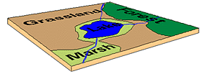
Vector Data
Vector data provide a way to represent real world features within the GIS environment. A vector feature has its shape represented using geometry. The geometry is made up of one or more interconnected vertices. A vertex describe a position in space using an x, y and optionally z axis. In the vector data model, features on the earth are represented as:
points
lines / routes
polygons / regions
TINs (triangulated irregular networks)

Slide 6
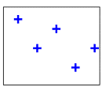
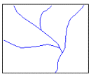
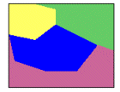
Vector Data
This system of recording features is based on the interaction between arcs and nodes, represented by points, lines and polygons. A point is a single node, a line is two nodes with an arc between them, and a polygon is a closed group of three or more arcs. With these three elements , it is possible to record most all necessary information.
Points Lines Polygons

Slide 7
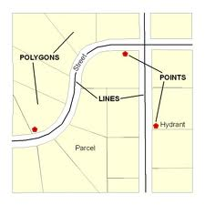
Vector Data
Vector data are good at
accurately representing true shape and size
representing non-continuous data (e.g., rivers, political boundaries, road lines, mountain peaks)
creating aesthetically pleasing maps
conserving disk space

Slide 8
Vector Data
Advantages : Data can be represented at its original resolution and form without generalization. Graphic output is usually more aesthetically pleasing (traditional cartographic representation); Since most data, e.g. hard copy maps, is in vector form no data conversion is required. Accurate geographic location of data is maintained.
Disadvantages: The location of each vertex needs to be stored explicitly. For effective analysis, vector data must be converted into a topological structure. This is often processing intensive and usually requires extensive data cleaning. As well, topology is static, and any updating or editing of the vector data requires re-building of the topology.

Slide 9
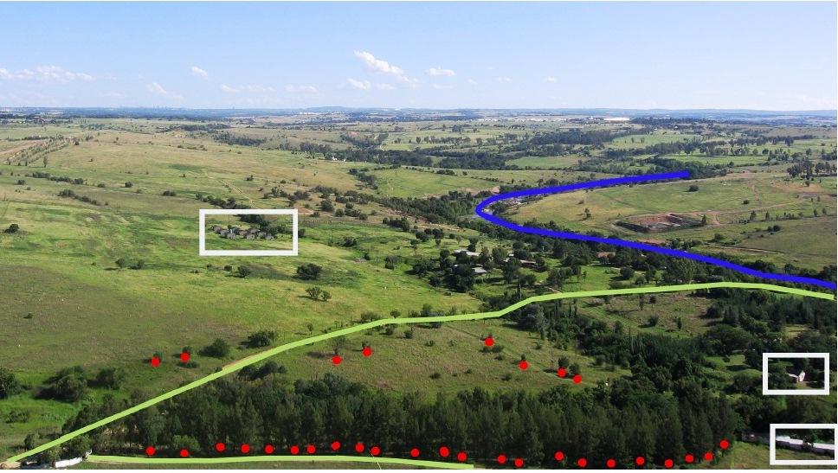
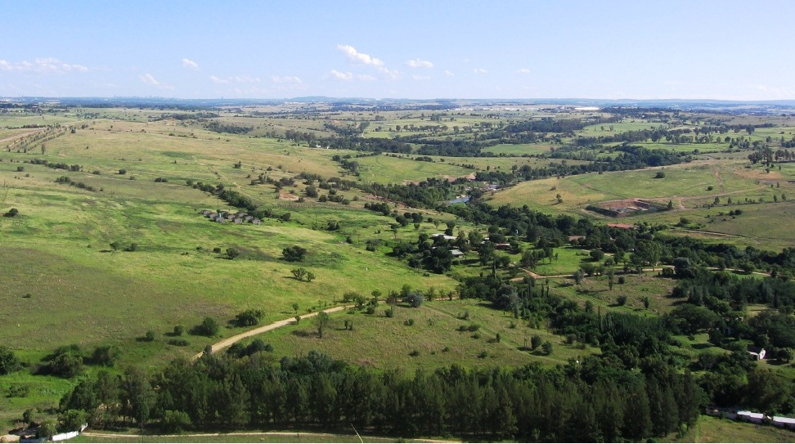
Vector Data

Slide 10
Vector Data

Slide 11
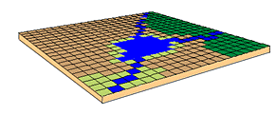
Raster Data
Raster Data – cell –based data such as aerial imagery and digital elevation models. Raster data is characterized by pixel values. Basically, a raster file is a giant table, where each pixel is assigned a specific value from 0 to 255. The meaning behind these values is specified by the user – they can represent elevations, temperature, hydrology and etc.

Slide 12
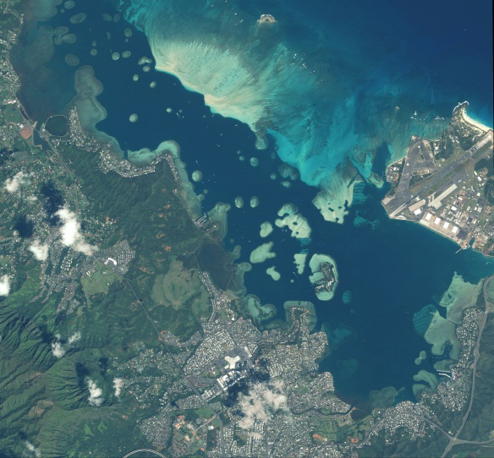
Raster Data
Raster data are good at:
representing continuous data (e.g., slope, elevation)
representing multiple feature types (e.g., points, lines, and polygons) as single feature types (cells)
rapid computations ("map algebra") in which raster layers are treated as elements in mathematical expressions
analysis of multi-layer or multivariate data (e.g., satellite image processing and analysis)
hogging disk space

Slide 13
Raster Data
Advantages : The geographic location of each cell is implied by its position in the cell matrix. Accordingly, other than an origin point, e.g. bottom left corner, no geographic coordinates are stored. Due to the nature of the data storage technique data analysis is usually easy to program and quick to perform. The inherent nature of raster maps, e.g. one attribute maps, is ideally suited for mathematical modeling and quantitative analysis. Grid-cell systems are very compatible with raster-based output devices, e.g. electrostatic plotters, graphic terminals.

Slide 14
Raster Data
Disadvantages: The cell size determines the resolution at which the data is represented.; It is especially difficult to adequately represent linear features depending on the cell resolution. Accordingly, network linkages are difficult to establish. Processing of associated attribute data may be cumbersome if large amounts of data exists. Raster maps inherently reflect only one attribute or characteristic for an area. Most output maps from grid-cell systems do not conform to high-quality cartographic needs.

Slide 15
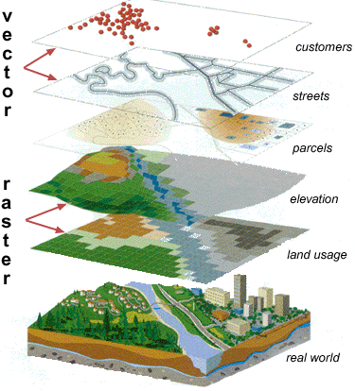
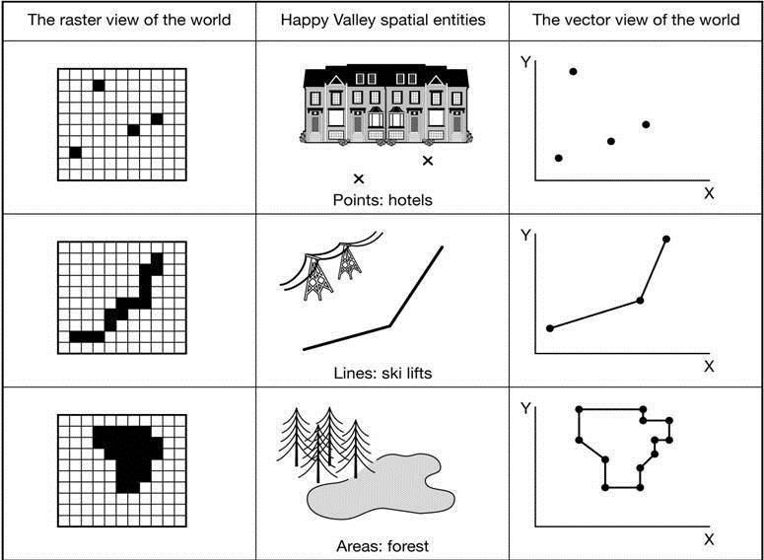
Visualization of Spatial Data

Slide 16
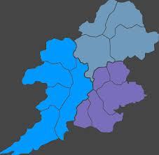
Visualization of Spatial Data (Maps)

Slide 17
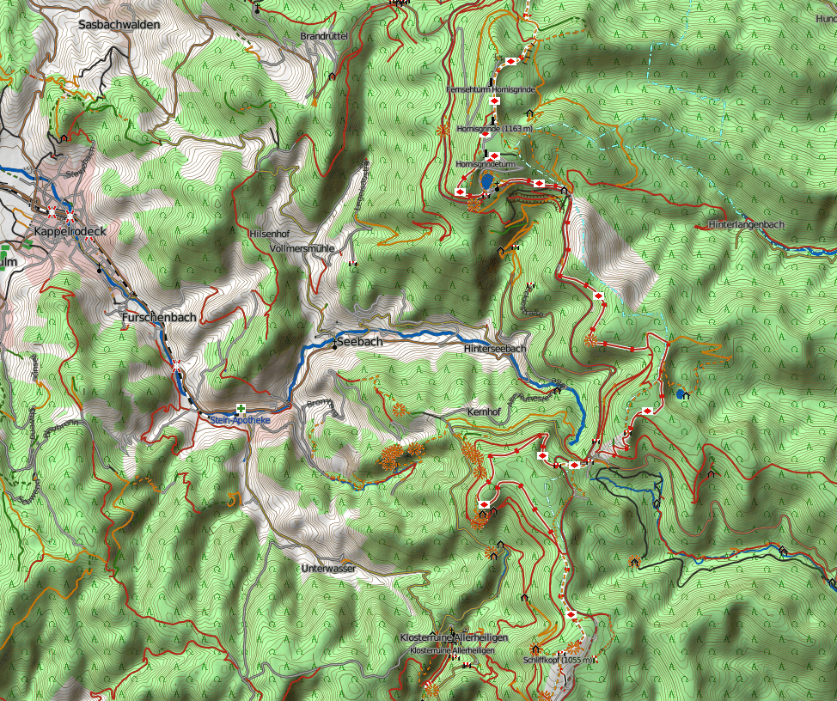
Visualization of Spatial Data (Maps)

Slide 18
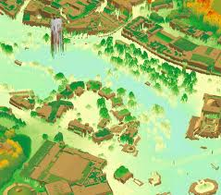
Visualization of Spatial Data (Maps)

Slide 19
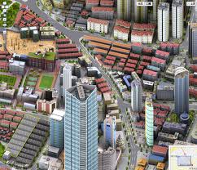
Visualization of Spatial Data (Maps)

Slide 20
Q u e r y a n d A n a l y s i s
Once you have a functioning GIS containing your geographic information, you can begin to ask simple questions such as
Where is there stressed vegetation?
How far is it between a contaminant source and a potentially exposed individual?
Where is land zoned for industrial use?
And analytical questions such as
Where are all the residences that could be exposed to this facility’s air emissions?
What is the dominant soil type for oak forest?
If I build a new highway here, how will traffic be affected?

Slide 21
A Core Benefit
GIS provides both simple point-and-click query capabilities and sophisticated analysis tools to provide timely information to managers and analysts alike. GIS technology really comes into its own when used to analyze geographic data to look for patterns and trends, and to undertake "what if" scenarios. Modern GISs have many powerful analytical tools, but two are especially important:
Proximity analysis
Overlay analysis

Slide 22
Proximity Analysis
Typical questions:
How many low income households houses lie within two miles of this proposed incinerator site?
What is the total number of soil samples within 50 feet of this pipeline?
What proportion of the alfalfa crop is within 500 m of the well?
How much of the site is within 100 feet of environmental contamination?
To answer such questions, GIS technology uses a process called buffering to determine the proximity relationship between features.

Slide 23
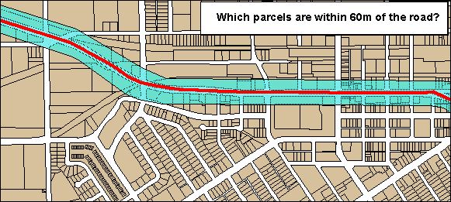
Buffering Lines
The blue band is a 60m buffer around the road

Slide 24
Buffering Points
The blue “balloon” is a buffer around the PCB hits (red points).
It helps solve the problem of where to sample.

Slide 25
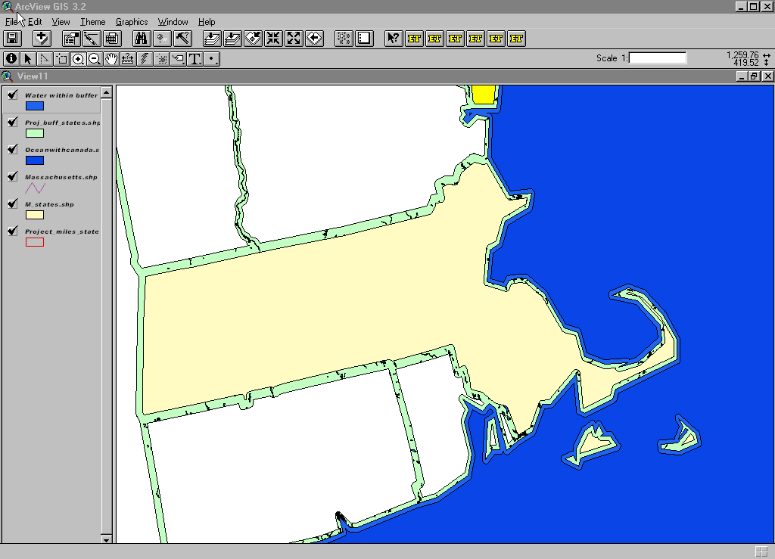
Buffer Generation
Creates new polygons by expanding or shrinking existing polygons or by creating polygons from points.

Slide 26
Overlay Analysis
The integration of different data layers involves a process called overlay. At its simplest, this could be a visual operation, but analytical operations require one or more data layers to be joined physically. This overlay, or spatial join, can integrate data on soils, slope, and vegetation, or land ownership with tax assessment.

Slide 27
Overlay Analysis—Finding Regions
The overlay of the buffer with the parcels solves the problem

Slide 28
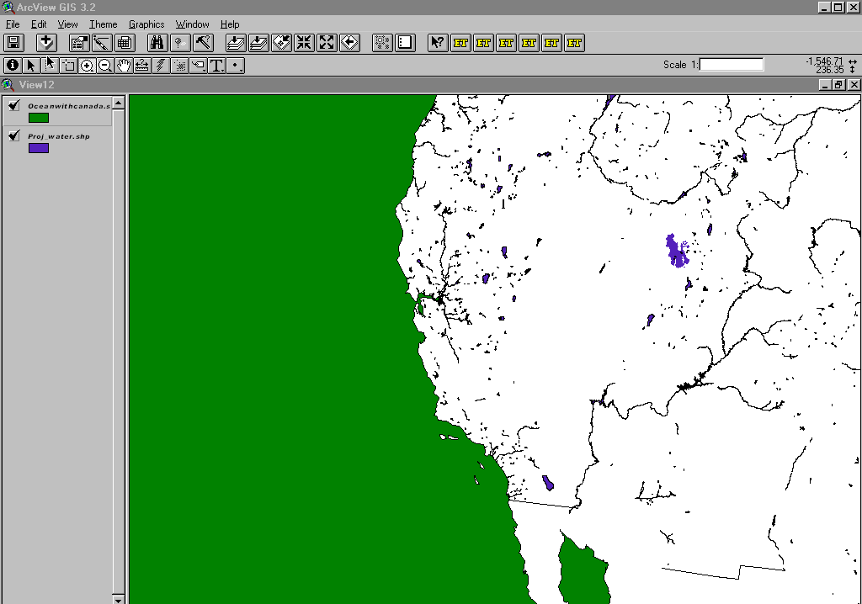
Polygon Overlay and Dissolve
Used when comparing two or more data layers.

Slide 29
Overlay Analysis—Selecting Points
Overlaying the buffer with a sitewide sampling grid determines where and how to sample

Slide 30
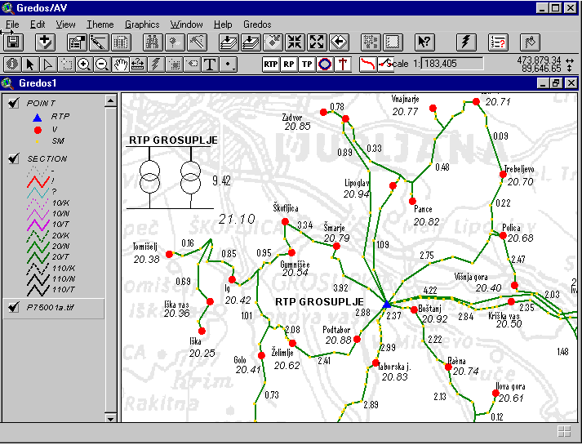
Network Analysis
Are techniques for routing resources along a set of linked linear features. Optimal path routing predicts the best route between two or more points based on distance, time, effort, or another measure. Often used for emergency response systems.

Slide 31
V i s u a l i z a t i o n
For many types of geographic operation the end result is best visualized as a map or graph. Maps are very efficient at storing and communicating geographic information. While cartographers have created maps for millennia, GIS provides new and exciting tools to extend the art and science of cartography. Map displays can be integrated with reports, three-dimensional views, photographic images, and other output, such as multimedia.

Slide 32
Geographic Information System Data
Spatial Data
Represents features that have a known location on earth.
Attribute Data
The information linked to the geographic features (spatial data) that describe those features.
Data Layers
Are the result of combining spatial and attribute data. Essentially adding the attribute database to the spatial location.
Layer Types
A layer type refers to the way spatial and attribute information are connected. There are two major layer types, vector and raster.
Topology
How geographic features are related to one another and where they are in relation to one another.

Slide 33
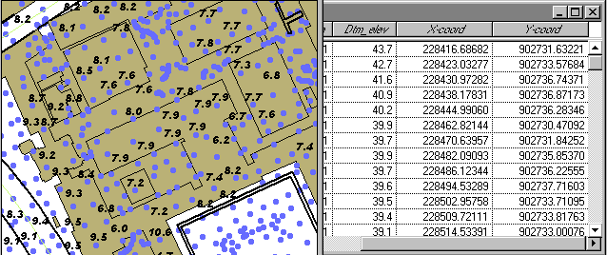
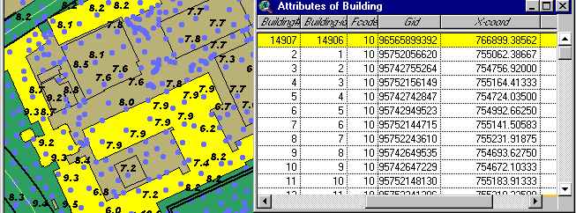
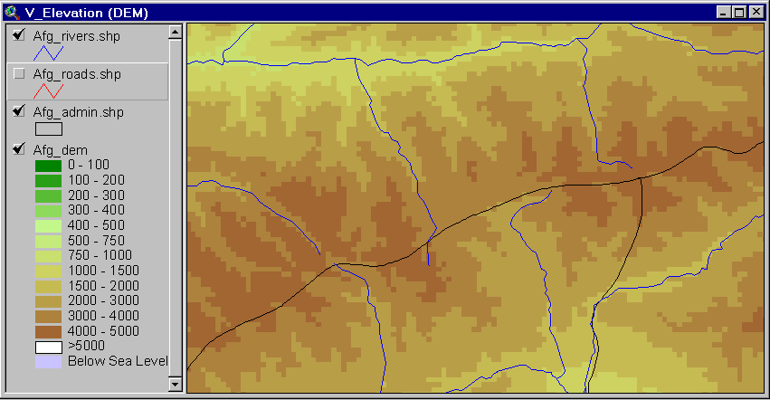
Spatial Data
Spatial or coordinate data represents features that have a known location on the earth.
Points: X & Y Locations
Line: Connected X & Y
Locations
Polygon: Connected X & Y Locations that contain attribute information.
Raster: Row and column matrix represent geographic space.

Slide 34
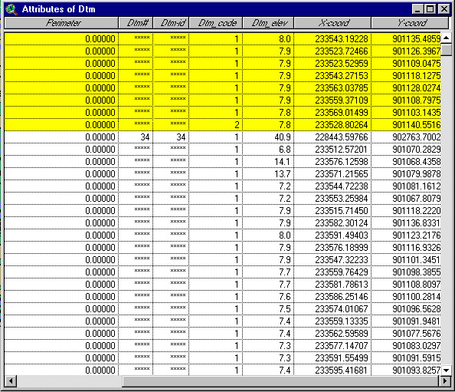
Attribute Data
Attribute data are the information linked to the geographic features (spatial data) that describe features. That is, attribute data are the “[n]on-graphic information associated with a point, line, or area elements in a GIS.”
O
O
O
2
1
1
1
O
2
1
1
1
1
O
O
2
1
1
1
1
1
1
O
1
0 : WATER
1 : HIGHLAND
2 : WETLAND

Slide 35
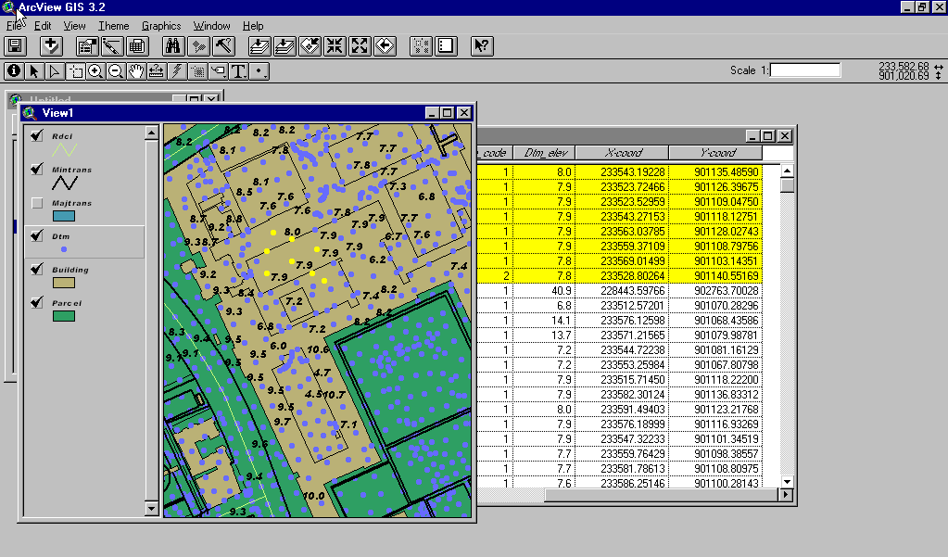
Data Layers
Are the result of combining spatial and attribute data. Essentially adding the attribute database to the spatial location.

Slide 36

Layer Types
A layer type refers to the way spatial and attribute information are connected. There are two major layer types, vector and raster.
Vector: Points, lines and polygons (spatial data) associated with databases of attributes (attribute data) are considered vector layer types.
O
O
2
0
O
2
1
1
1
1
O
1
1
2
1
1
O
O
2
1
1
1
1
1
1
O
1
1
Raster: A row and column matrix (pixels) of X & Y space with attribute information associated with each pixel is considered a raster layer type.
O
O
O
2
1
1
1
O
2
1
1
1
0 : WATER
1 : HIGHLAND
2 : WETLAND
1
O
O
2
1
1
1
1
1
1
O
1

Slide 37
Topology
Topology is the “way in which geographical elements are linked together”. Topology is how geographic features are related to one another and where they are in relation to one another.
Topology is the critical element that distinguishes a GIS from a graphics or automated cartography system. It is essential to the ability of a GIS to employ spatial relationships. Topology is what enables a GIS to emulate our human ability to discern and manipulate geographic relationships.
A
B
C
D
Parcel B is surrounded by
Parcel A and Parcel C

Slide 38


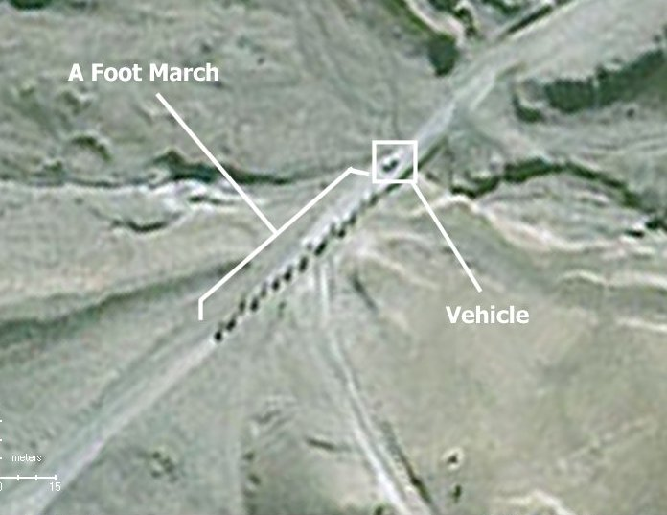
Software / Hardware
GIS software programs are usually either vector or
raster based with capabilities in using both layer types.
Vector Based Software
ArcView
ArcMap
MapInfo
Raster Based Software
Erdas Imagine
IDRISI

Slide 39
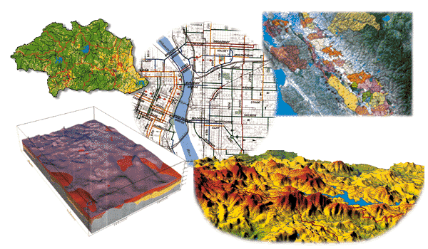
Conclusions
GIS is rapidly becoming a key technology to support decision making at all scales
The near future will continue to see accelerating growth in data availability and computing power to support GIS
The strategic decision to make now is not whether, but when and how to use GIS to support environmental studies and decisions

Slide 40
Thank you for your attention!

